Slide 1
Vehicle Routing Problem (VRP)

Slide 2
Disclaimer/Invite
We will do some nice modelling using MILP.
The models presented here can be solved with a MIP solver if they are small enough.
Generally, we will need heuristics and commercially people build their own software.
This is an incredibly active area, so anyone interested who would like to look into this problem and possible new methods (maybe AI related) please speak to me.

Slide 3
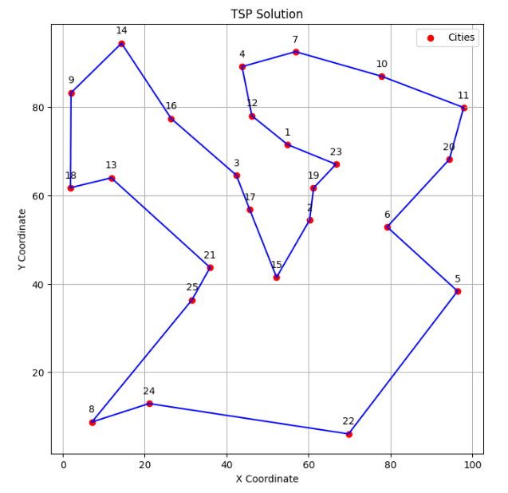
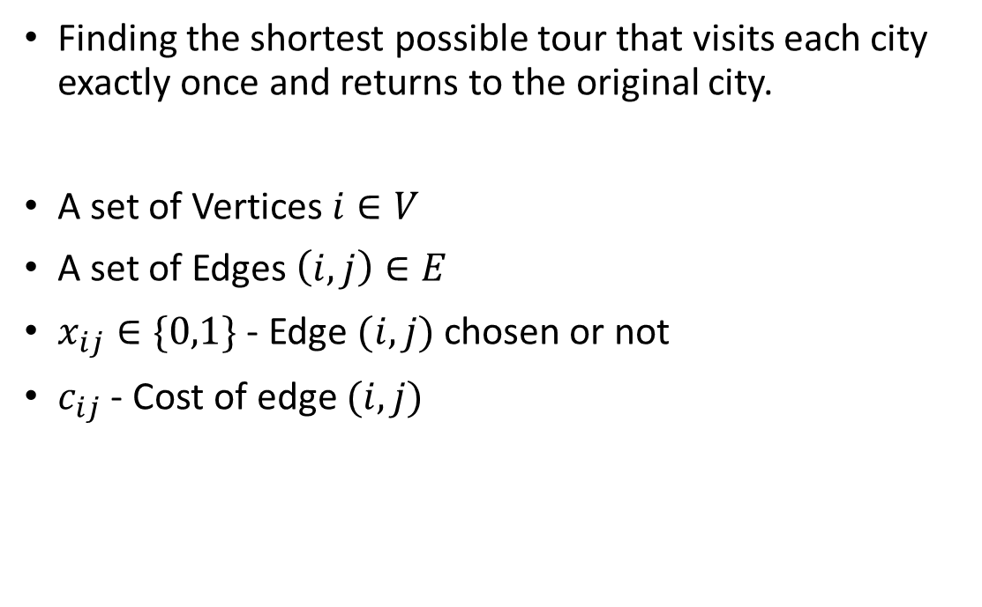
Travelling Salesman Reminder
Finding the shortest possible tour that visits each city exactly once and returns to the original city.
A set of Vertices $i∈V$
A set of Edges $\left(i,j\right)∈E$
$x_{ij}∈\{0,1\}$ - Edge $(i,j)$ chosen or not
$c_{ij}$ - Cost of edge $(i,j)$

Slide 4
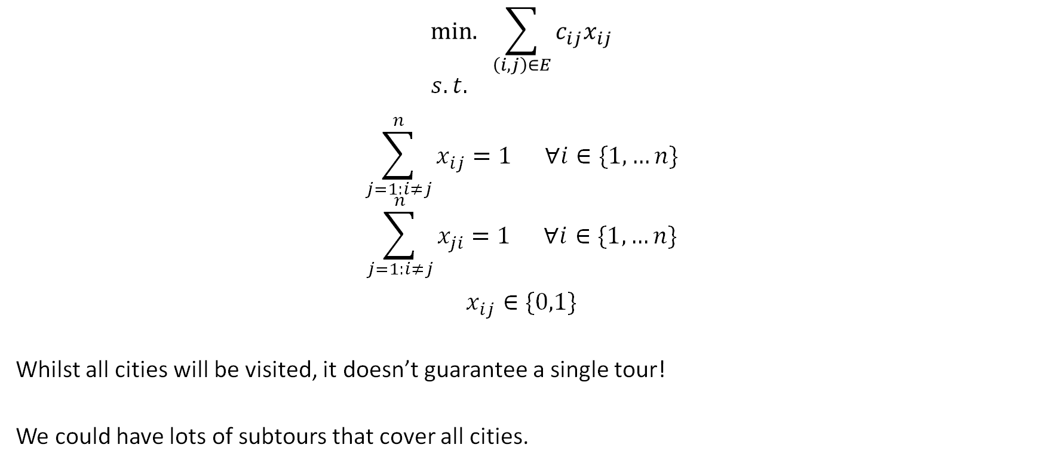
MILP
$$\text{min}\text{. }\sum_{\left(i,j\right)∈E}{c_{ij}x_{ij}} \\ s.t.$$
$$\sum_{j=1:i≠j}^{n}{x_{ij}=1 ∀i∈\{1, …n\}}$$
$$\sum_{j=1:i≠j}^{n}{x_{ji}=1 ∀i∈\{1, …n\}}$$
$$x_{ij}∈\{0,1\}$$
Whilst all cities will be visited, it doesn’t guarantee a single tour!
We could have lots of subtours that cover all cities.

Slide 5
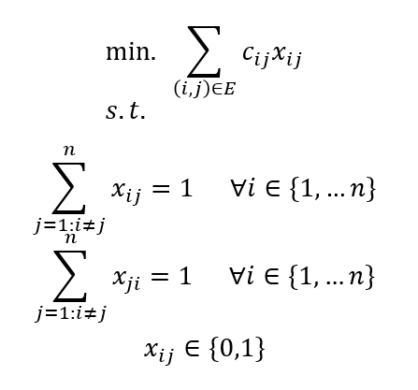
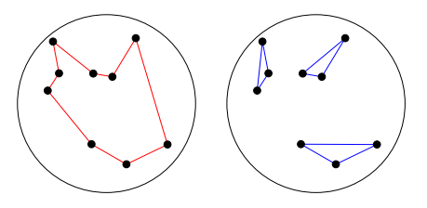
Subtour example
Both the red (complete tour) and the blue (subtours) have exactly one edge entering and one edge leaving a city!

Slide 6
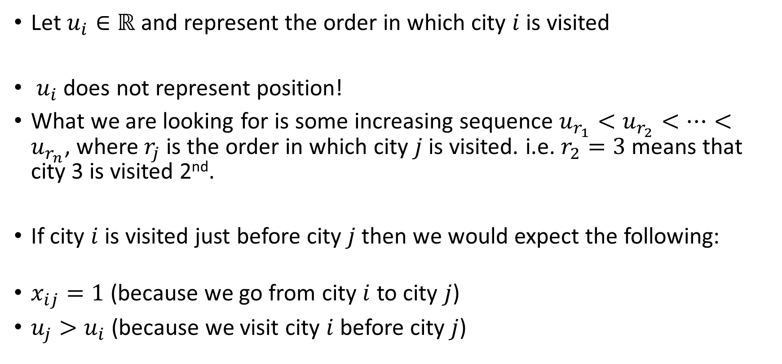
TSP MTZ Constraint
Let $u_{i}∈ℝ$ represent the order in which city $i$ is visited
$u_{i}$ need not equal the position: only the order of the values matters.
What we are looking for is some increasing sequence $u_{r_{1}}<u_{r_{2}}<…<u_{r_{n}}$, where $r_{k}$ is the city visited $k$-th, i.e. $r_{2}=3$ means that city 3 is visited second.
If city $i$ is visited just before city $j$ then we would expect the following:
$x_{ij}=1$ (because we go from city $i$ to city $j$)
$u_{j}>u_{i}$ (because we visit city $i$ before city $j$)

Slide 7
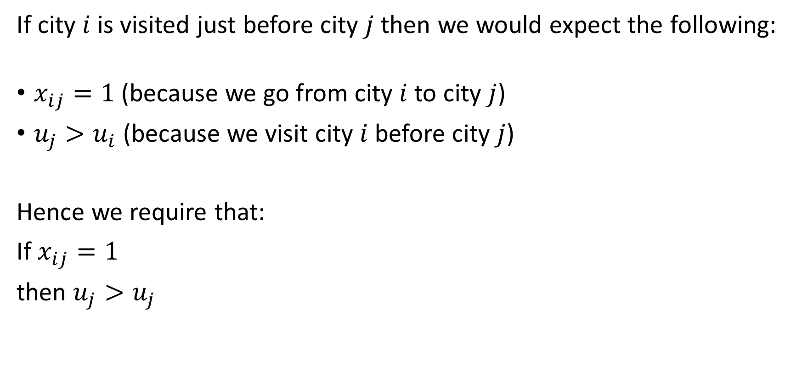
TSP MTZ Constraint
If city $i$ is visited just before city $j$ then we would expect the following:
$x_{ij}=1$ (because we go from city $i$ to city $j$)
$u_{j}>u_{i}$ (because we visit city $i$ before city $j$)
Hence we require that:
If $x_{ij}=1$
then $u_{j}>u_{i}$

Slide 8
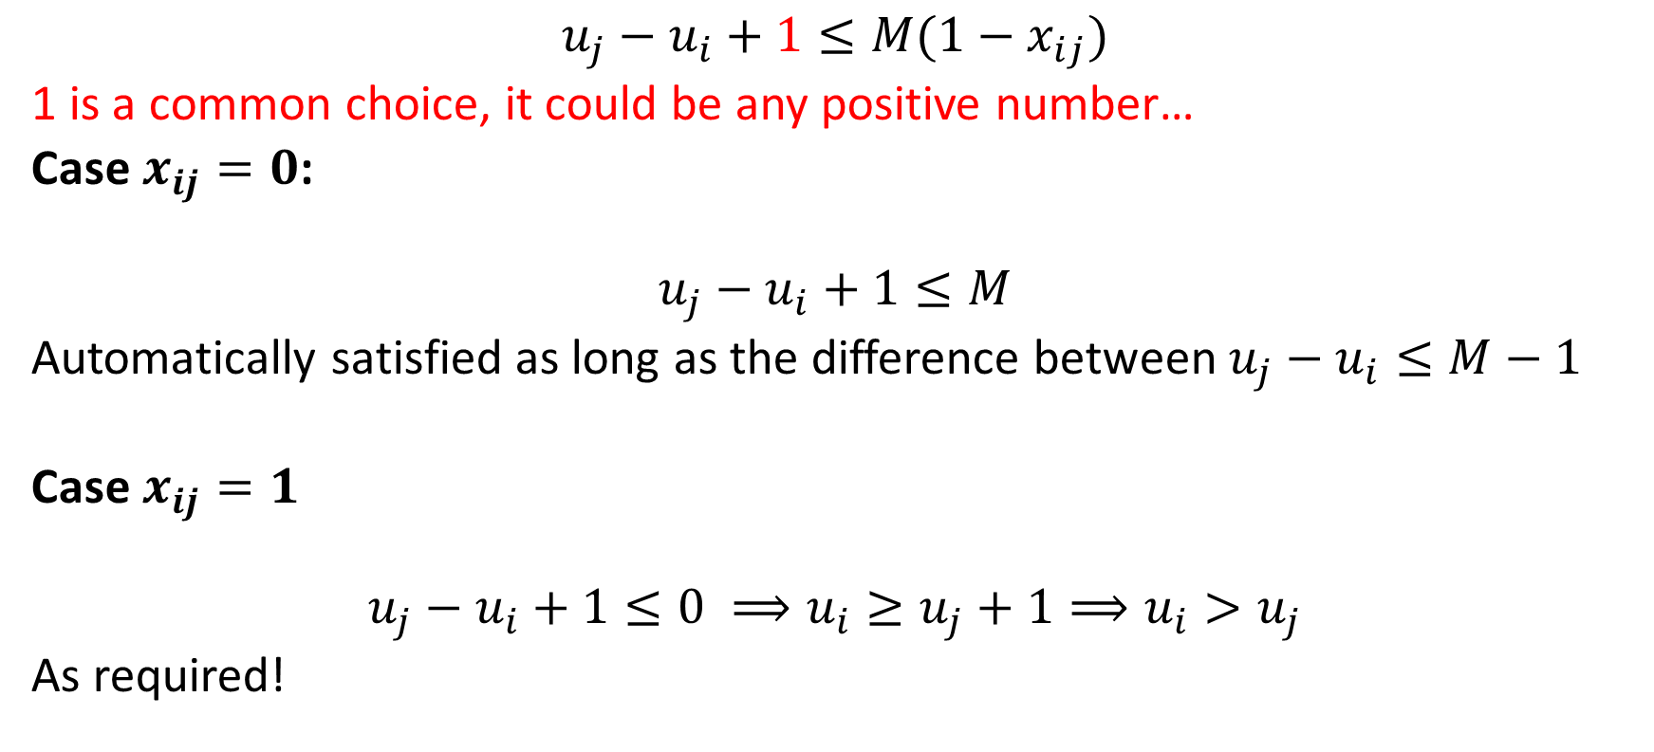
TSP MTZ Constraint
$$u_{i}−u_{j}+1≤M(1−x_{ij})$$
1 is a common choice, it could be any positive number…
Case $x_{ij}=0$:
$$u_{i}−u_{j}+1≤M$$
Automatically satisfied as long as $u_{i}−u_{j}≤M−1$
Case $x_{ij}=1$
$$u_{i}−u_{j}+1≤0 ⟹u_{j}≥u_{i}+1⟹u_{j}>u_{i}$$
As required!

Slide 9
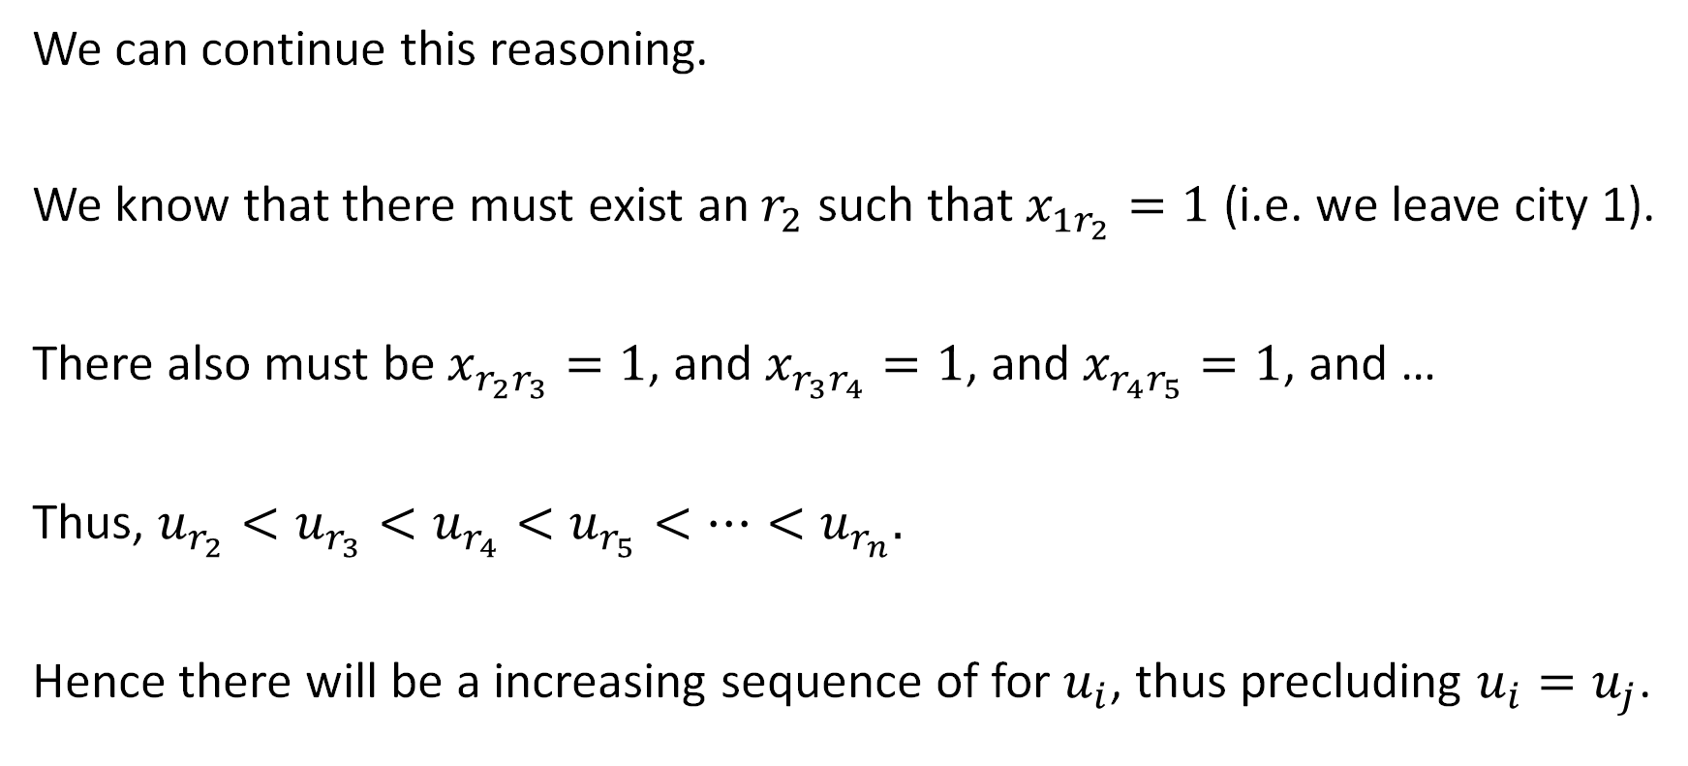
Why does this work?
We can continue this reasoning.
We know that there must exist an $r_{2}$ such that $x_{1r_{2}}=1$ (i.e. we leave city 1).
There also must be $x_{r_{2}r_{3}}=1$, and $x_{r_{3}r_{4}}=1$, and $x_{r_{4}r_{5}}=1$, and …
Thus, $u_{r_{2}}<u_{r_{3}}<u_{r_{4}}<u_{r_{5}}<…<u_{r_{n}}.$
Hence there will be an increasing sequence of $u_{i}$, thus precluding $u_{i}=u_{j}$.

Slide 10
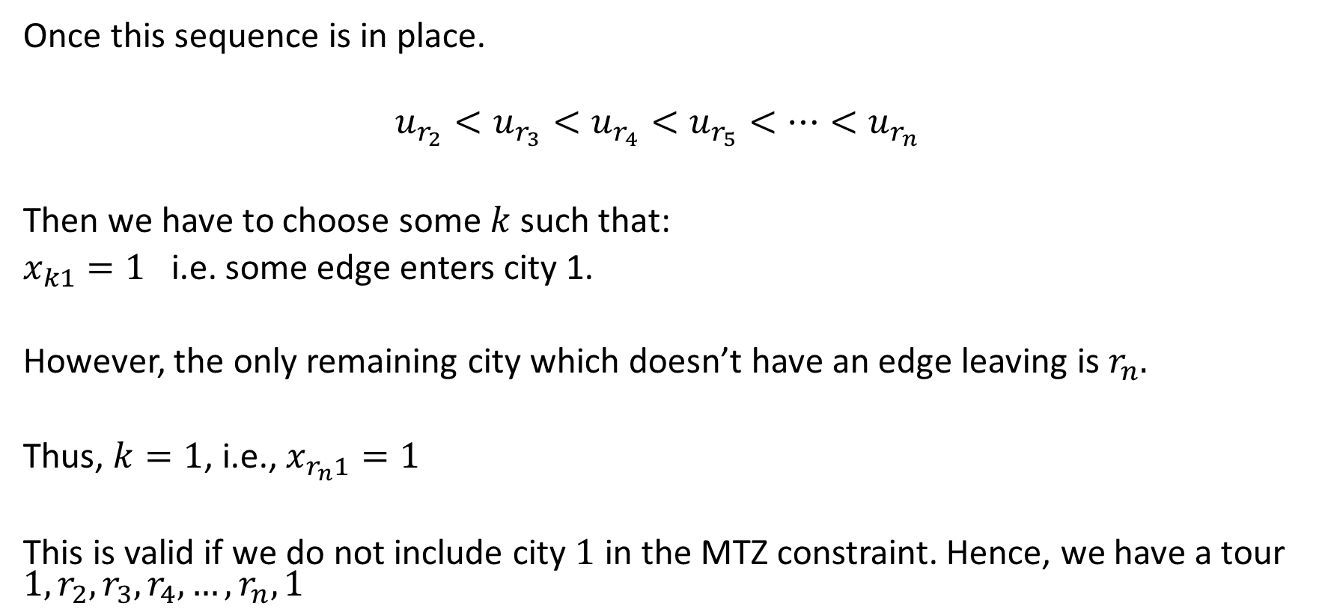
Why does this work?
Once this sequence is in place.
$$u_{r_{2}}<u_{r_{3}}<u_{r_{4}}<u_{r_{5}}<…<u_{r_{n}}$$
Then we have to choose some $k$ such that:
$x_{k1}=1$ i.e. some edge enters city 1.
However, the only remaining city which doesn’t have an edge leaving is $r_{n}.$
Thus, $k=r_{n}$, i.e., $x_{r_{n}1}=1$
This is valid if we do not include city $1$ in the MTZ constraint. Hence, we have a tour $1,r_{2},r_{3},r_{4},…,r_{n},1$

Slide 11
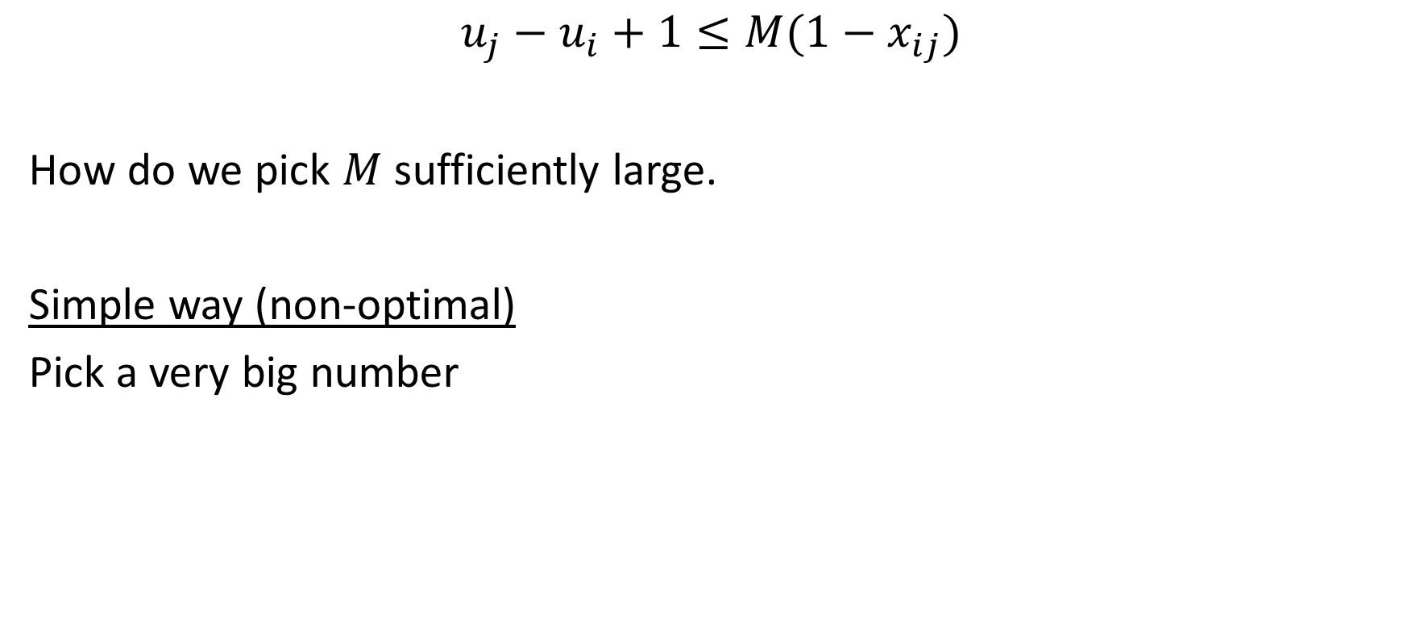
TSP MTZ Constraint
$$u_{i}−u_{j}+1≤M(1−x_{ij})$$
How do we pick $M$ sufficiently large?
Simple way (non-optimal)
Pick a very big number

Slide 12
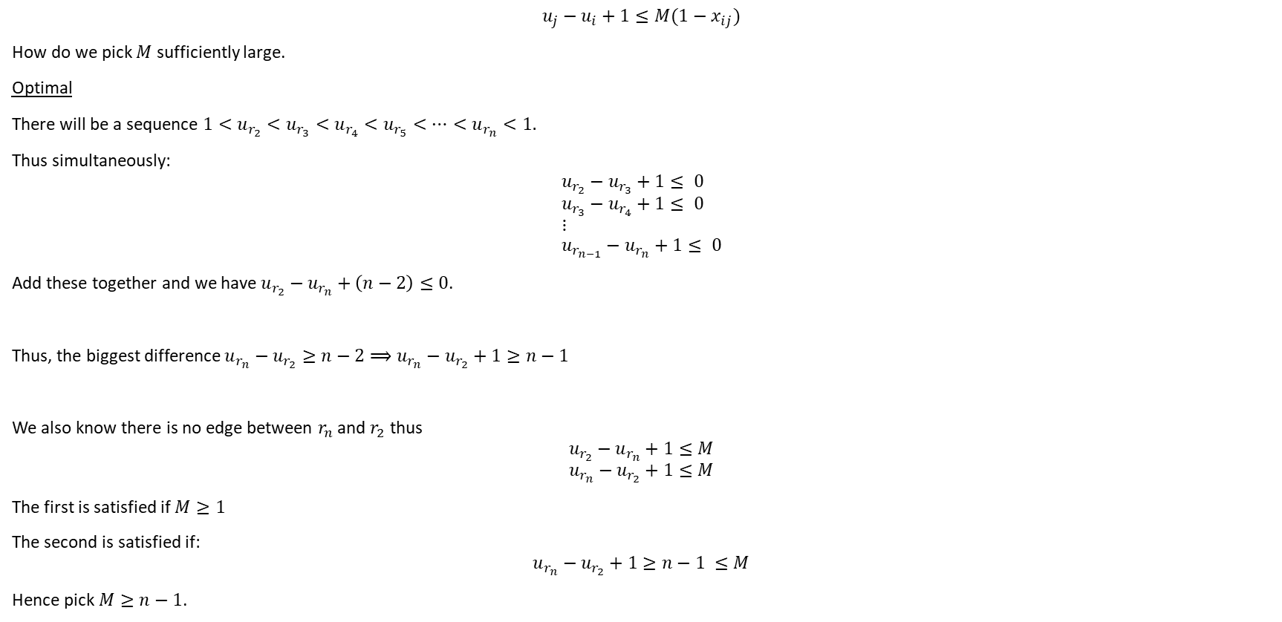
TSP MTZ Constraint
$$u_{i}−u_{j}+1≤M(1−x_{ij})$$
How do we pick $M$ sufficiently large?
Optimal
Along the tour (after city 1) there will be a sequence $u_{r_{2}}<u_{r_{3}}<u_{r_{4}}<u_{r_{5}}<…<u_{r_{n}}.$
Thus simultaneously:
$$u_{r_{2}}−u_{r_{3}}+1≤ 0 \\ u_{r_{3}}−u_{r_{4}}+1≤ 0 \\ ⋮ \\ u_{r_{n−1}}−u_{r_{n}}+1≤ 0$$
Add these together and we have $u_{r_{2}}−u_{r_{n}}+\left(n−2\right)≤0$.
Thus, the biggest difference $u_{r_{n}}−u_{r_{2}}≥n−2⟹u_{r_{n}}−u_{r_{2}}+1≥n−1$
We also know there is no edge between $r_{n}$ and $r_{2}$ thus
$$u_{r_{2}}−u_{r_{n}}+1≤M$$
$$u_{r_{n}}−u_{r_{2}}+1≤M$$
The first is satisfied if $M≥1$
The second is satisfied if:
$$M≥u_{r_{n}}−u_{r_{2}}+1≥n−1$$
Hence pick $M≥n−1$.

Slide 13
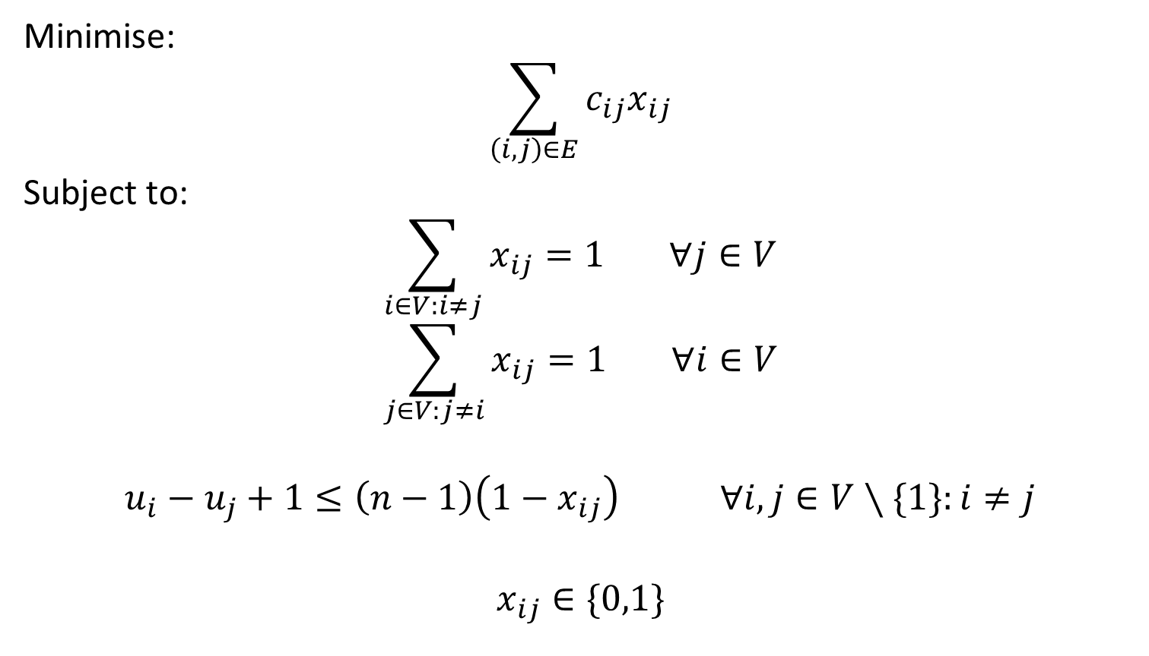
Compact with Set Notation
Minimise:
$$\sum_{\left(i,j\right)∈E}{c_{ij}x_{ij}}$$
Subject to:
$$\sum_{i∈V:i≠j}{x_{ij}=1} ∀j∈V$$
$$\sum_{j∈V:j≠i}{x_{ij}=1} ∀i∈V$$
$$u_{i}−u_{j}+1≤\left(n−1\right)\left(1−x_{ij}\right) ∀i,j∈V∖\{1\}:i≠j$$
$$x_{ij}∈\{0,1\}$$

Slide 14
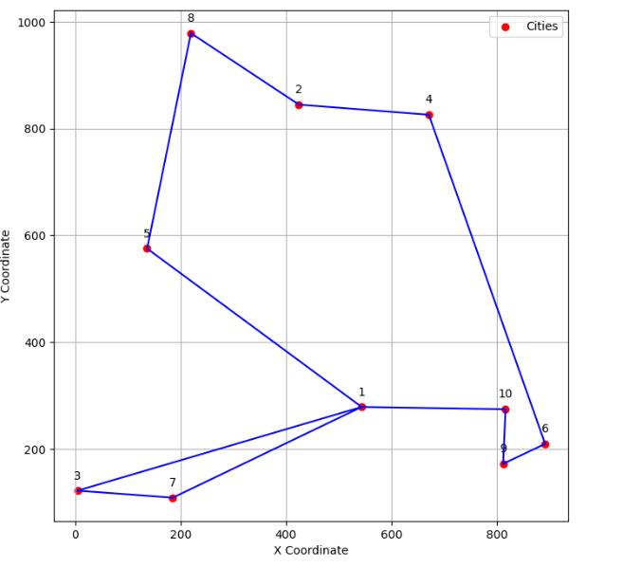
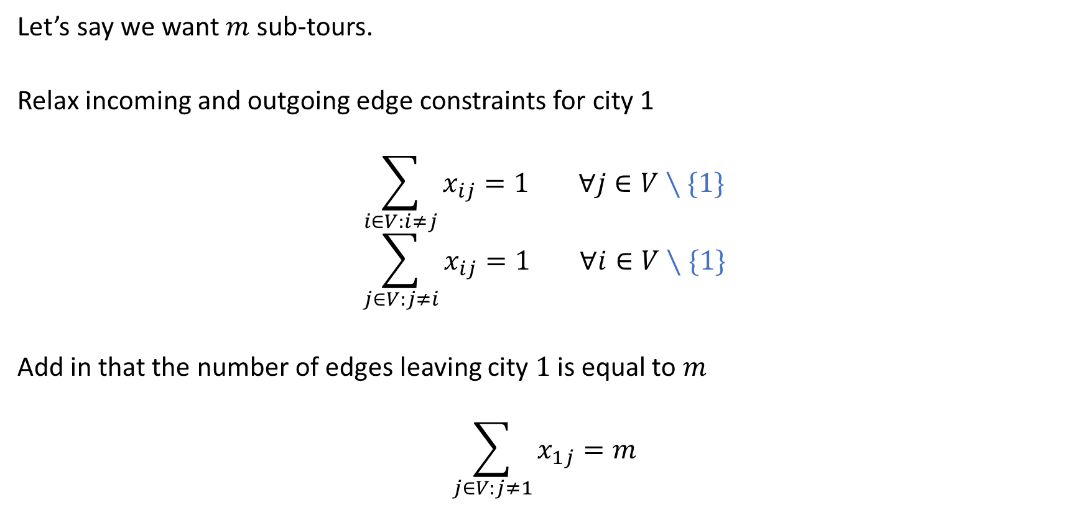
Extending the TSP to Allow Multiple Tours
Let’s say we want $m$ sub-tours.
Relax incoming and outgoing edge constraints for city 1
$$\sum_{i∈V:i≠j}{x_{ij}=1} ∀j∈V∖\{1\}$$
$$\sum_{j∈V:j≠i}{x_{ij}=1} ∀i∈V∖\{1\}$$
Add in that the number of edges leaving city $1$ is equal to $m$
$$\sum_{j∈V:j≠1}{x_{1j}=m}$$

Slide 15
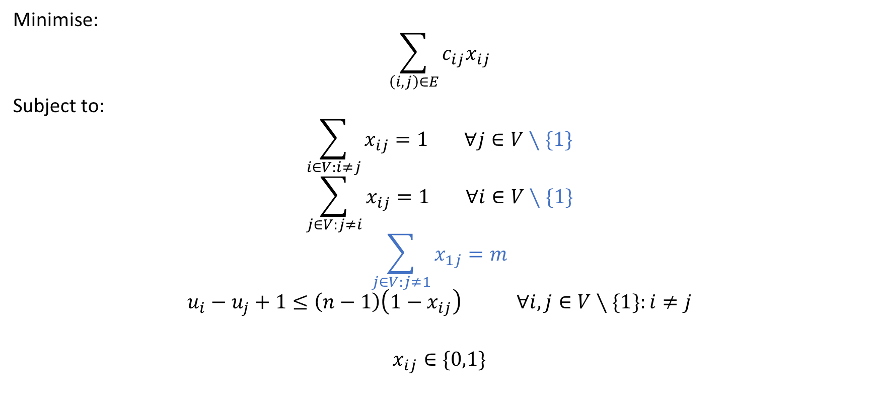
Extending the TSP to Allow Multiple Tours
Minimise:
$$\sum_{\left(i,j\right)∈E}{c_{ij}x_{ij}}$$
Subject to:
$$\sum_{i∈V:i≠j}{x_{ij}=1} ∀j∈V∖\{1\}$$
$$\sum_{j∈V:j≠i}{x_{ij}=1} ∀i∈V∖\{1\}$$
$$\sum_{j∈V:j≠1}{x_{1j}=m}$$
$$u_{i}−u_{j}+1≤\left(n−1\right)\left(1−x_{ij}\right) ∀i,j∈V∖\{1\}:i≠j$$
$$x_{ij}∈\{0,1\}$$
$V∖\{1\}$ is the set V without 1, e.g. for n cities, $V=\left\{1,2,…,n\right\}$ and $V∖\left\{1\right\}=\{2,…,n\}$

Slide 16
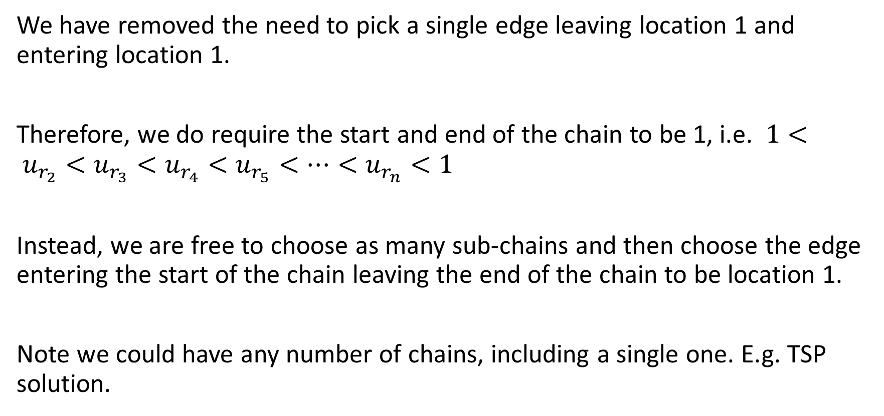
Why does this work?
We have removed the need to pick a single edge leaving location 1 and entering location 1.
Therefore, we no longer need one single chain through all the cities, i.e. $u_{r_{2}}<u_{r_{3}}<u_{r_{4}}<u_{r_{5}}<…<u_{r_{n}}$
Instead, we can build several chains and join both ends of each chain to location 1.
Note we could have any number of chains, including a single one. E.g. TSP solution.

Slide 17
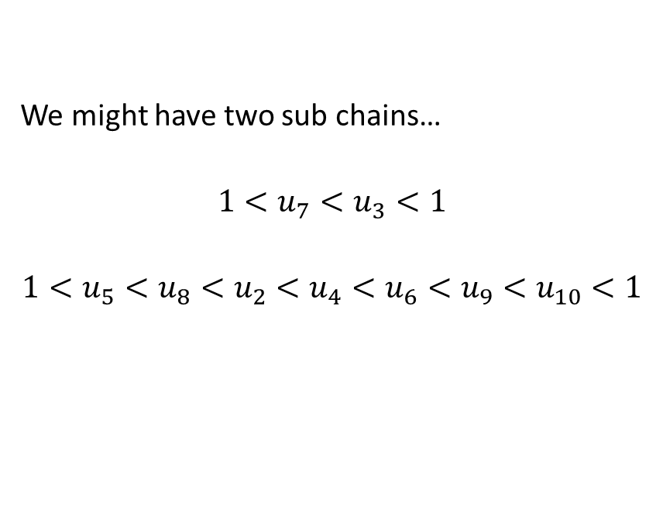
Illustration
We might have two chains, each joined to location 1 at both ends (routes 1 → 7 → 3 → 1 and 1 → 5 → … → 10 → 1):
$$u_{7}<u_{3}$$
$$u_{5}<u_{8}<u_{2}<u_{4}<u_{6}<u_{9}<u_{10}$$

Slide 18
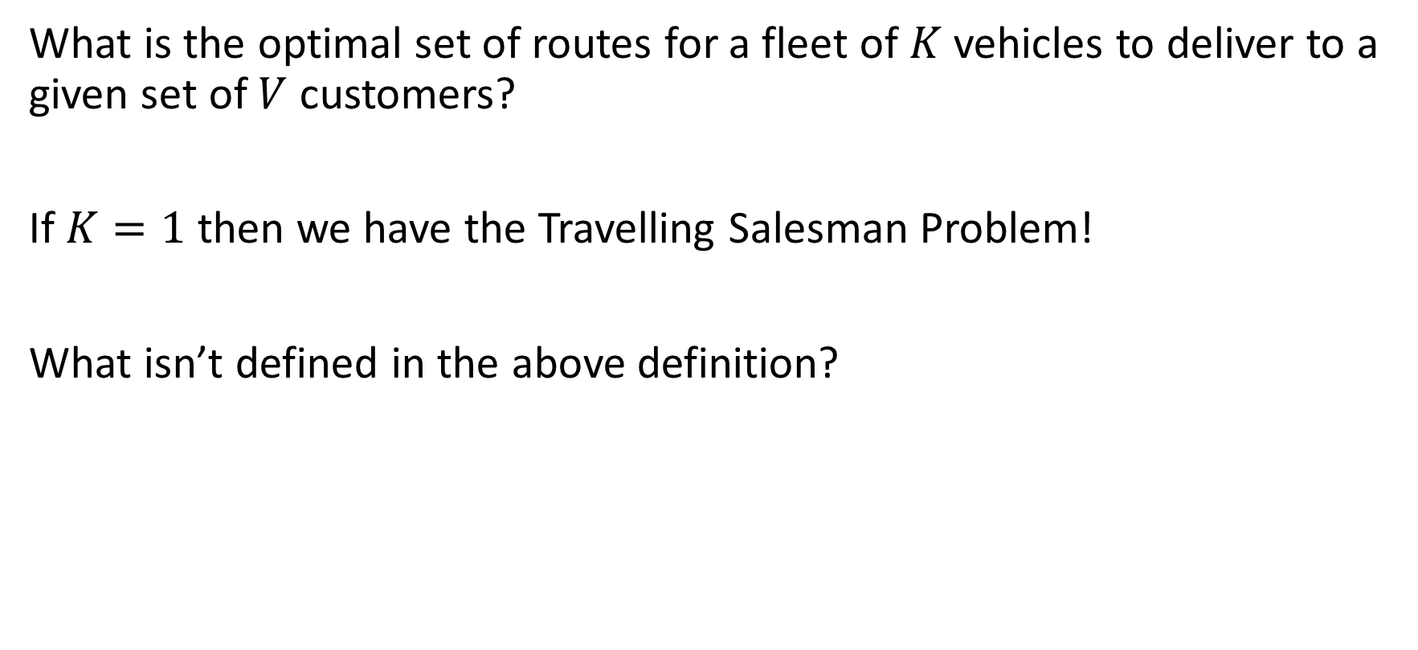
Basic VRP Definition (Woolly)
What is the optimal set of routes for a fleet of $m$ vehicles to deliver to a given set of $V$ customers?
If $m=1$ then we have the Travelling Salesman Problem!
What isn’t defined in the above definition?

Slide 19
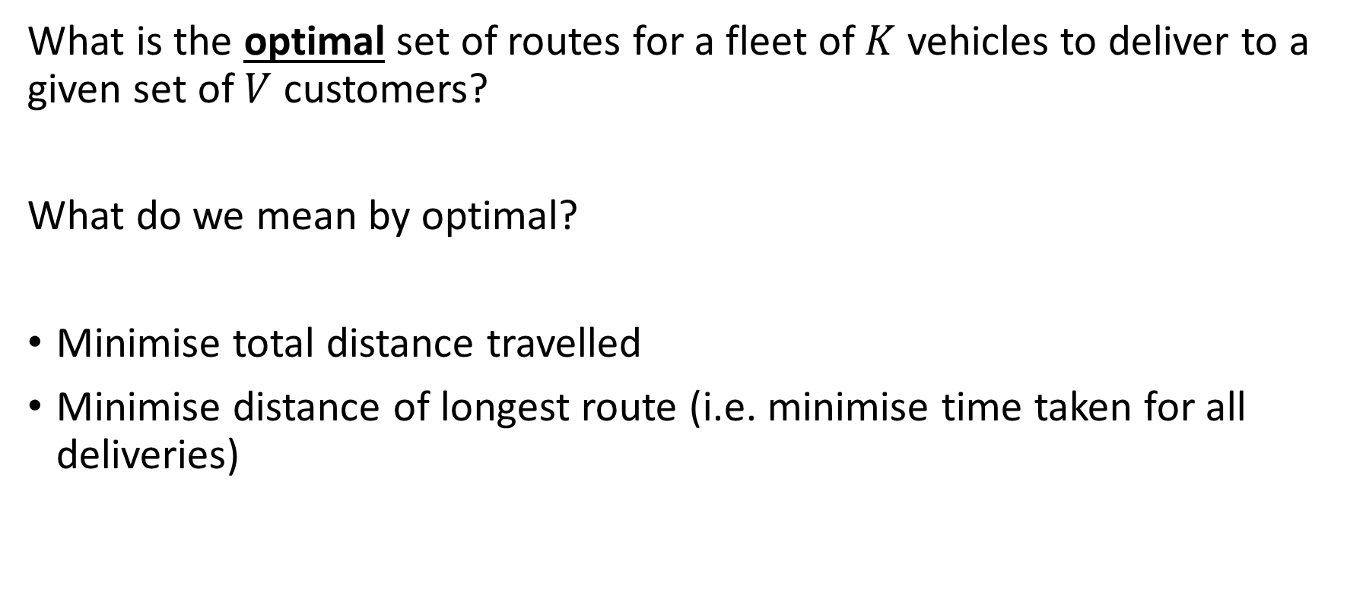
What is the objective?
What is the optimal set of routes for a fleet of $m$ vehicles to deliver to a given set of $V$ customers?
What do we mean by optimal?
Minimise total distance travelled
Minimise distance of longest route (i.e. minimise time taken for all deliveries)

Slide 20
Demand and capacity?
Demand
There is no demand for the delivery? This might be OK for the Royal Mail, but you can imagine a certain amount that needs to be shipped to a location.
Even for the Royal Mail, if every delivery is one uniform parcel, the demand is roughly one parcel per location.
Capacity
There is no capacity for a vehicle (route).
No idea if the route can carry the demand needed. i.e. is the van big enough?

Slide 21
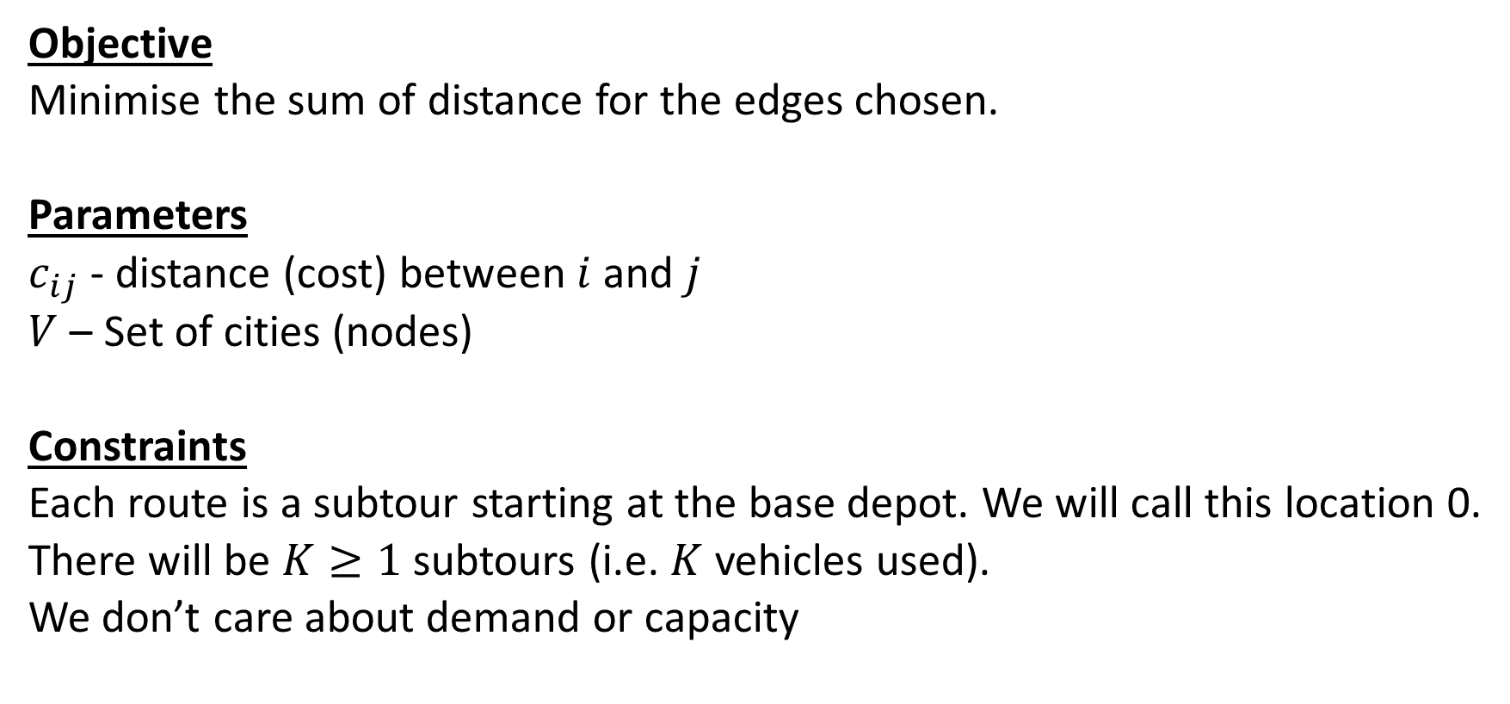
Minimise the total distance
Objective
Minimise the sum of distance for the edges chosen.
Parameters
$c_{ij}$ - distance (cost) between $i$ and $j$
$V$ – Set of cities (nodes)
Constraints
Each route is a subtour starting at the base depot. We will call this location 1.
There will be $m≥1$ subtours (i.e. $m$ vehicles used).
We don’t care about demand or capacity

Slide 22
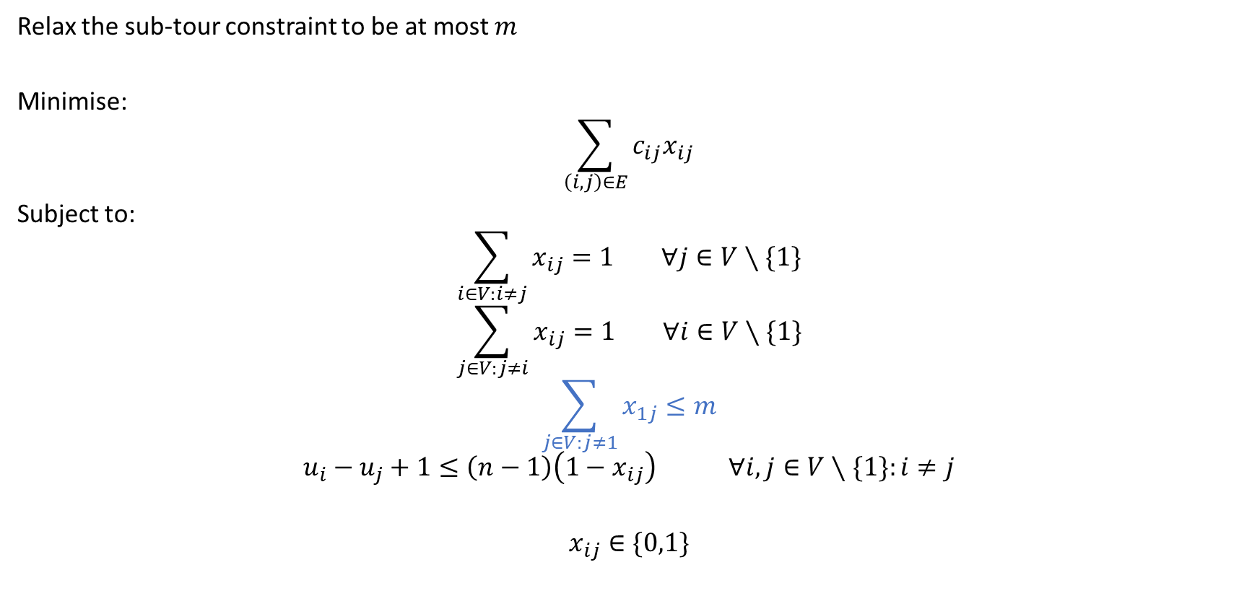
Minimise the total distance
Relax the depot constraint: at most $m$ edges leave city 1
Minimise:
$$\sum_{\left(i,j\right)∈E}{c_{ij}x_{ij}}$$
Subject to:
$$\sum_{i∈V:i≠j}{x_{ij}=1} ∀j∈V∖\{1\}$$
$$\sum_{j∈V:j≠i}{x_{ij}=1} ∀i∈V∖\{1\}$$
$$\sum_{j∈V:j≠1}{x_{1j}≤m}$$
$$u_{i}−u_{j}+1≤\left(n−1\right)\left(1−x_{ij}\right) ∀i,j∈V∖\{1\}:i≠j$$
$$x_{ij}∈\{0,1\}$$
$V∖\{1\}$ is the set V without 1, e.g. for n cities, $V=\left\{1,2,…,n\right\}$ and $V∖\left\{1\right\}=\{2,…,n\}$

Slide 23
Pros and Cons
It will find you the optimal number of vehicles to minimise distance travelled.
It does not have capacity or demand built in.
Therefore, if the distances obey the triangle inequality, a single vehicle (the TSP tour) is always one of the best solutions.

Slide 24
Minimise total distance with capacity and demand
Issue!
We can get long routes for some vans, short for others.
This might be fine, but it is likely that a company would like to deliver things quickly.

Slide 25
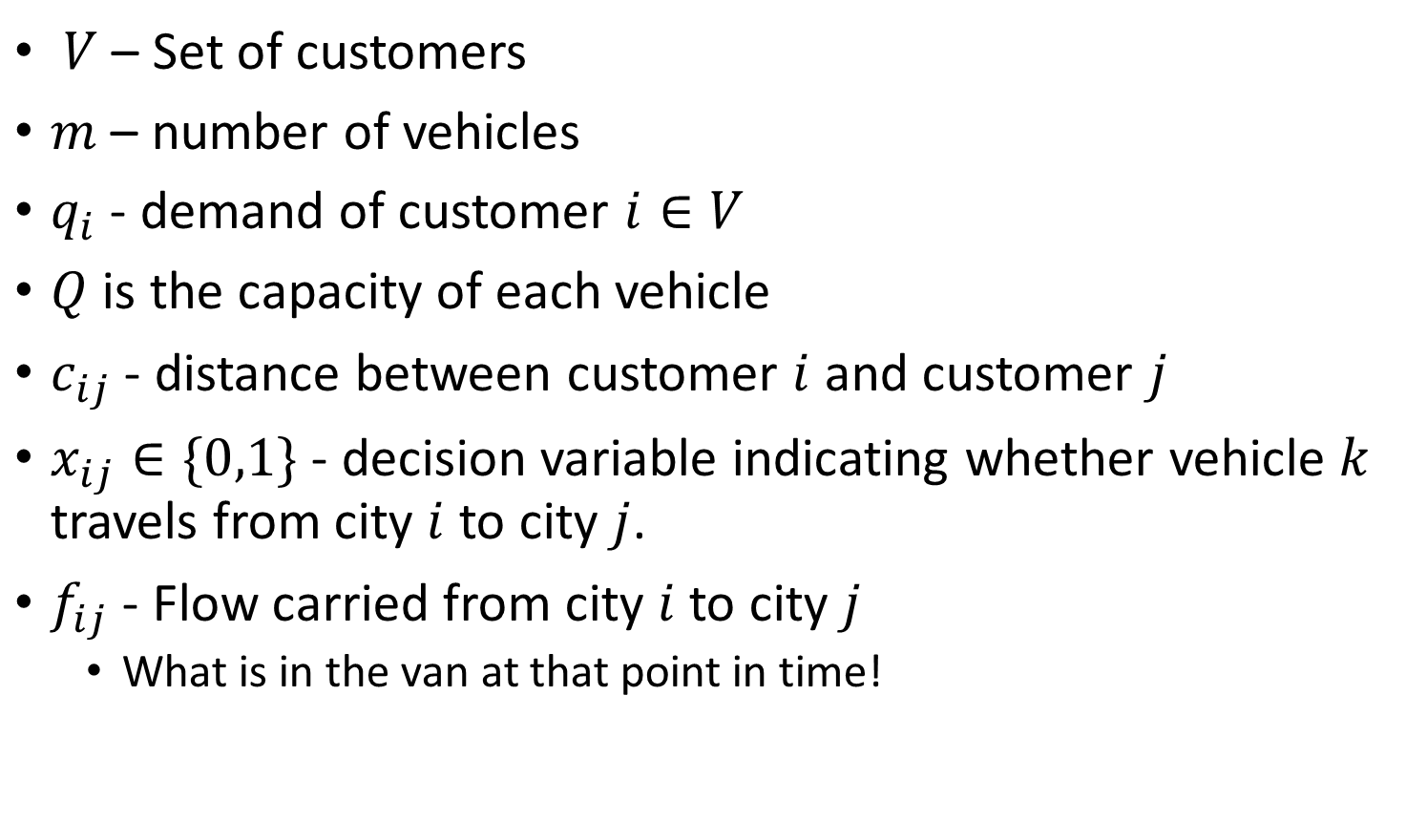
Full Notation
$V$ – Set of locations (city 1 is the depot)
$m$ – number of vehicles
$q_{i}$ - demand of customer $i∈V$
$Q$ is the capacity of each vehicle
$c_{ij}$ - distance between customer $i$ and customer $j$
$x_{ij}∈\{0,1\}$ - decision variable indicating whether a vehicle travels from city $i$ to city $j$.
$f_{ij}$ - Flow carried from city $i$ to city $j$
  What is in the van at that point in time!

Slide 26
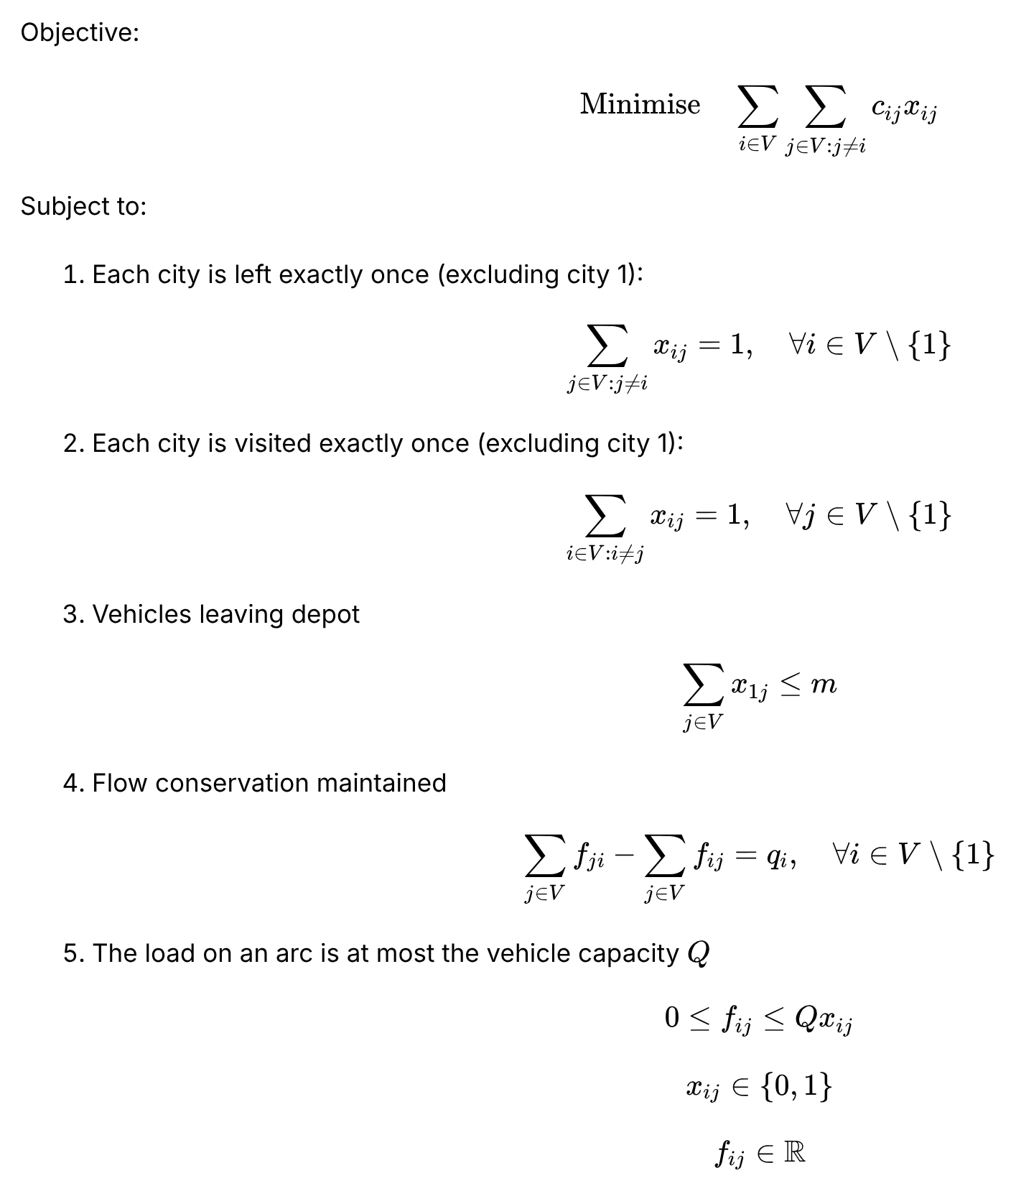
Minimise total distance with capacity and demand

Slide 27
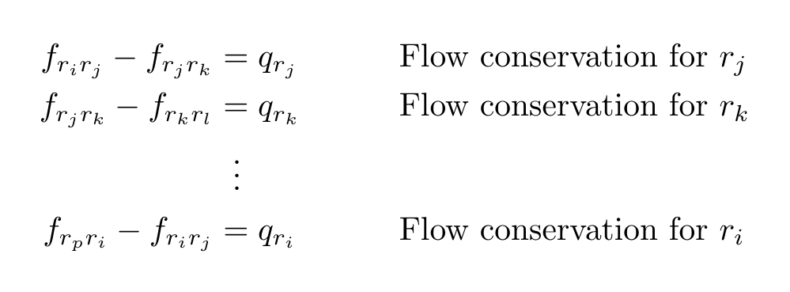

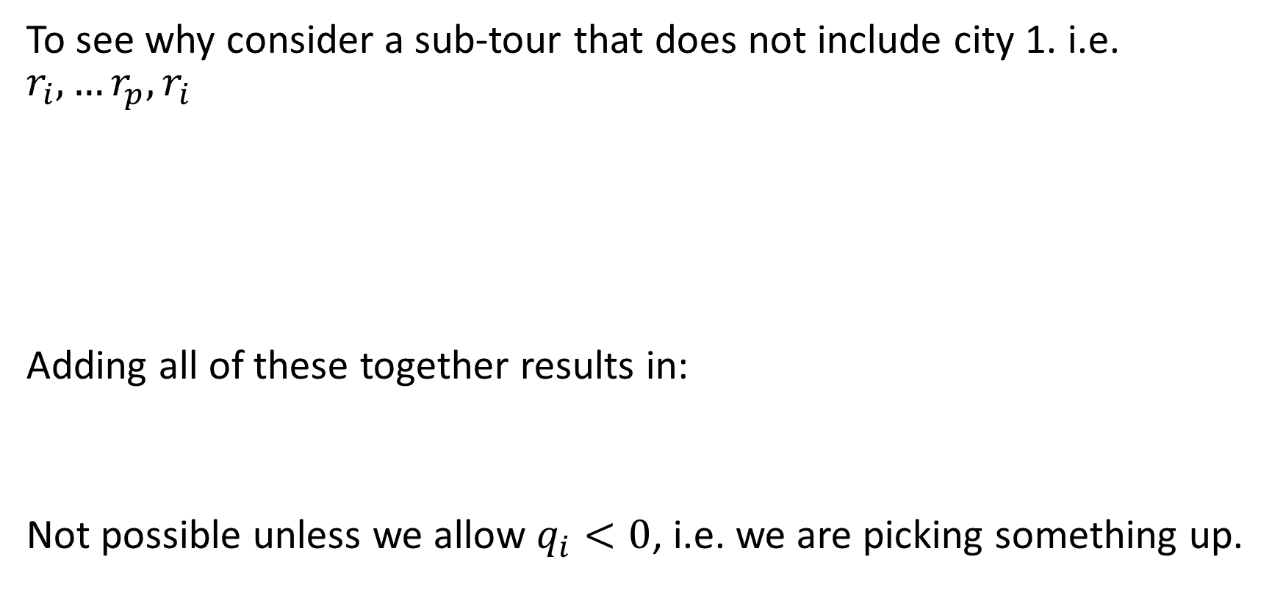
Why didn’t we include the sub-tour constraints?
To see why consider a sub-tour that does not include city 1. i.e. $r_{i}, …r_{p},r_{i}$
Adding all of these together results in:
Not possible if every customer has $q_{i}>0$. A subtour needs some demand ≤ 0: a pick-up or a stop with no demand.

Slide 28
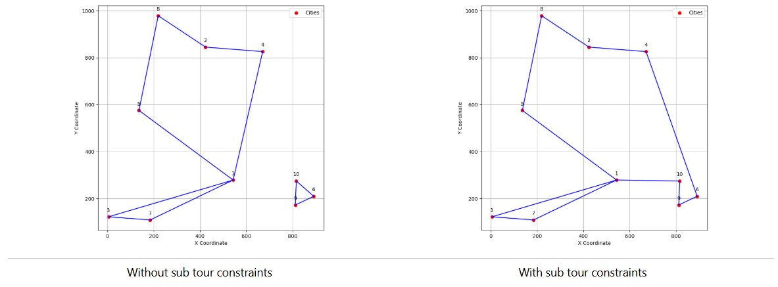
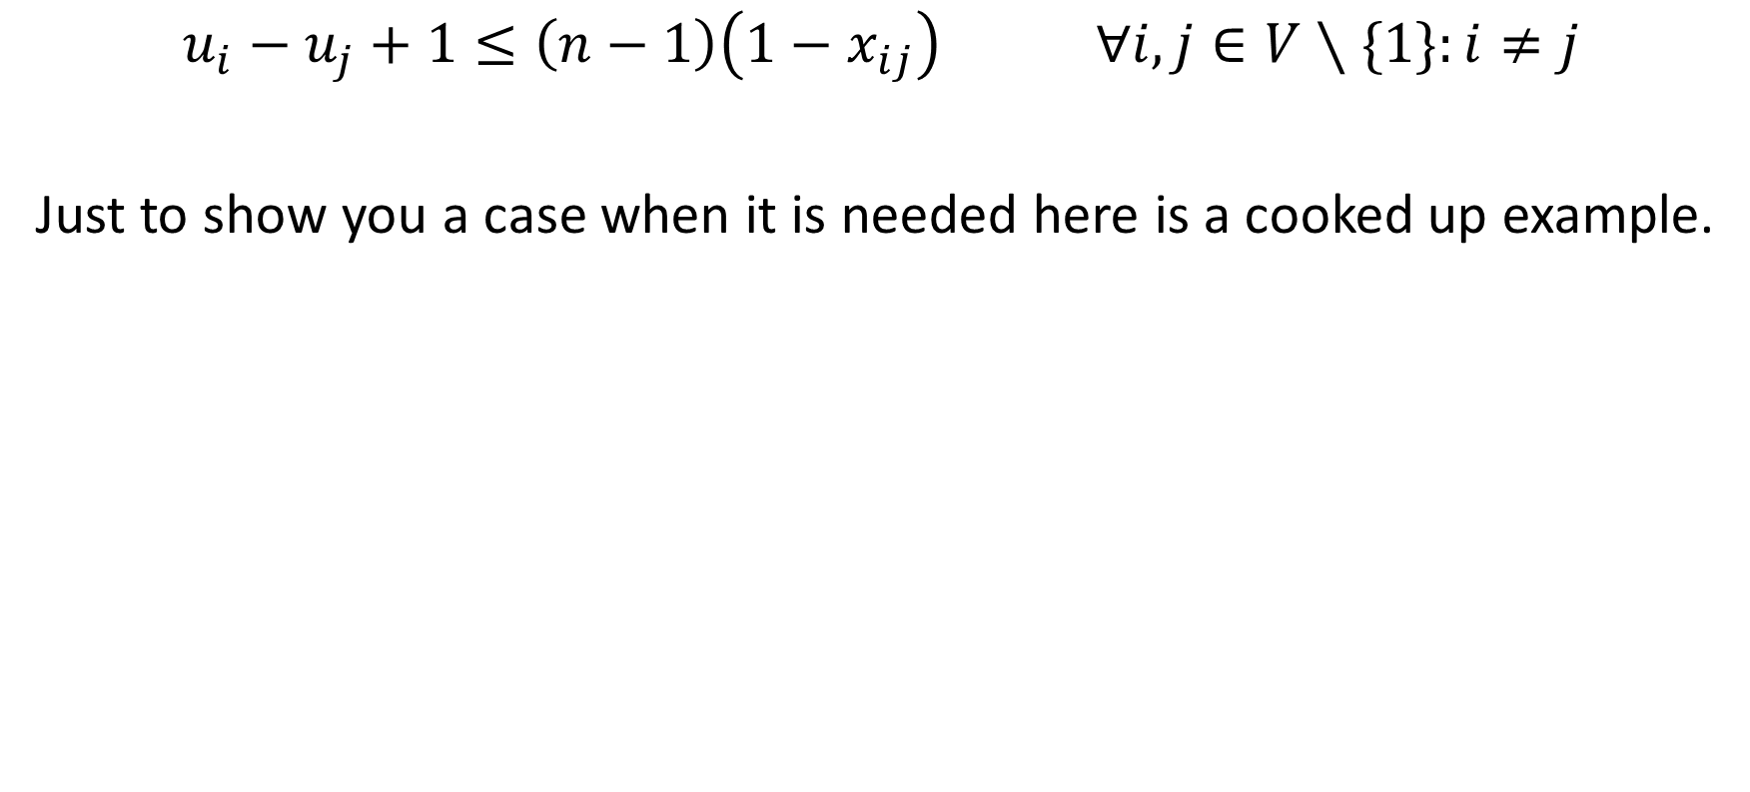
Cooked up example
$$u_{i}−u_{j}+1≤\left(n−1\right)\left(1−x_{ij}\right) ∀i,j∈V∖\{1\}:i≠j$$
A cooked-up example where it is needed: a flow model in which some customers’ demands add up to zero (pick-ups or zero demands).

Slide 29
Deliver all orders as quickly as possible
We can reframe this objective as minimise the maximum route length of a vehicle.
This is known as a minimax problem.
To do this we will need to know the length of each of the routes for the vehicles
A nice way to visualise this idea is to imagine we are creating a copy of the network for each vehicle
  We can then track which edges are used in each of the networks.
  We can work out the length of each tour
  Minimise the maximum length of all tours considered.

Slide 30
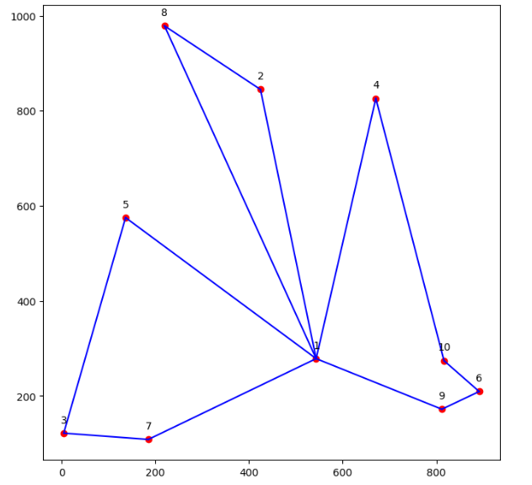
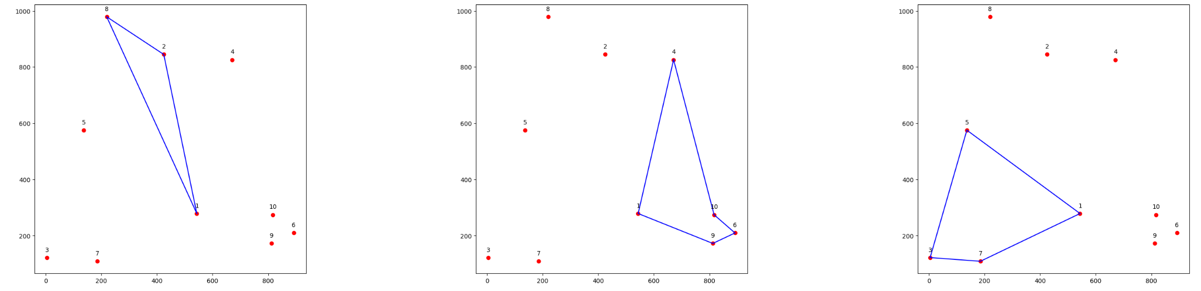
Illustration

Slide 31
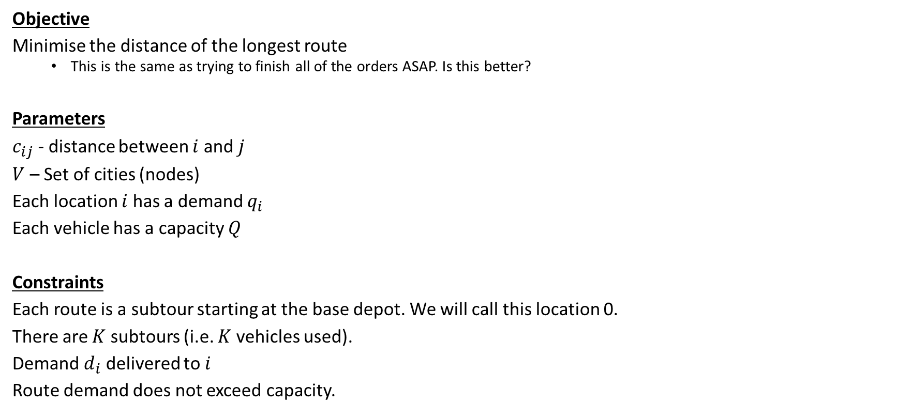
Minimise the distance of the longest route
Objective
Minimise the distance of the longest route
  This is the same as trying to finish all of the orders ASAP. Is this better?
Parameters
$c_{ij}$ - distance between $i$ and $j$
$V$ – Set of cities (nodes)
Each location $i$ has a demand $q_{i}$
Each vehicle has a capacity $Q$
Constraints
Each route is a subtour starting at the base depot. We will call this location 1.
There are at most $m$ subtours (i.e. at most $m$ vehicles used).
Demand $q_{i}$ delivered to $i$
Route demand does not exceed capacity.

Slide 32
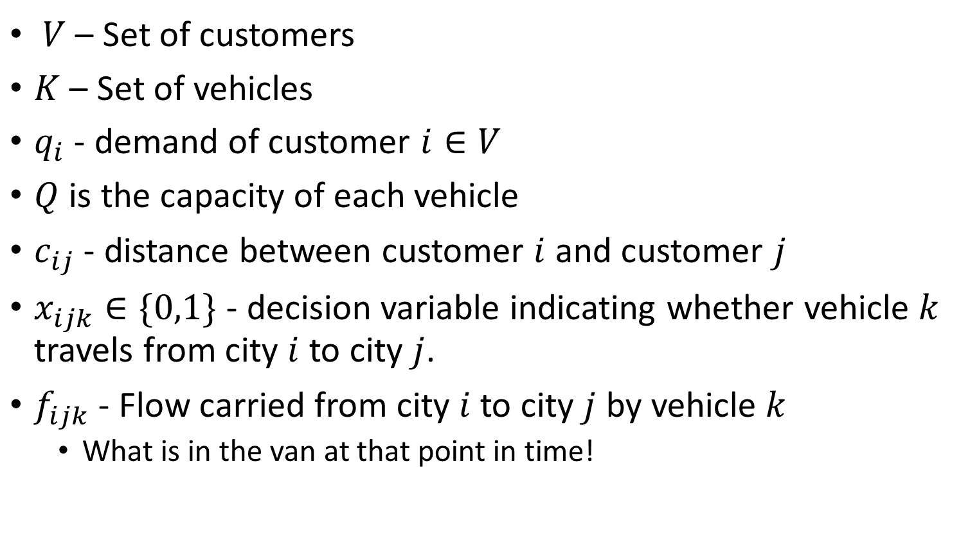
Full Notation
$V$ – Set of locations (city 1 is the depot)
$K$ – Set of vehicles
$m$ – number of vehicles that may leave the depot
$q_{i}$ - demand of customer $i∈V$
$Q$ is the capacity of each vehicle
$c_{ij}$ - distance between customer $i$ and customer $j$
$x_{ijk}∈\{0,1\}$ - decision variable indicating whether vehicle $k$ travels from city $i$ to city $j$.
$f_{ijk}$ - Flow carried from city $i$ to city $j$ by vehicle $k$
  What is in the van at that point in time!

Slide 33
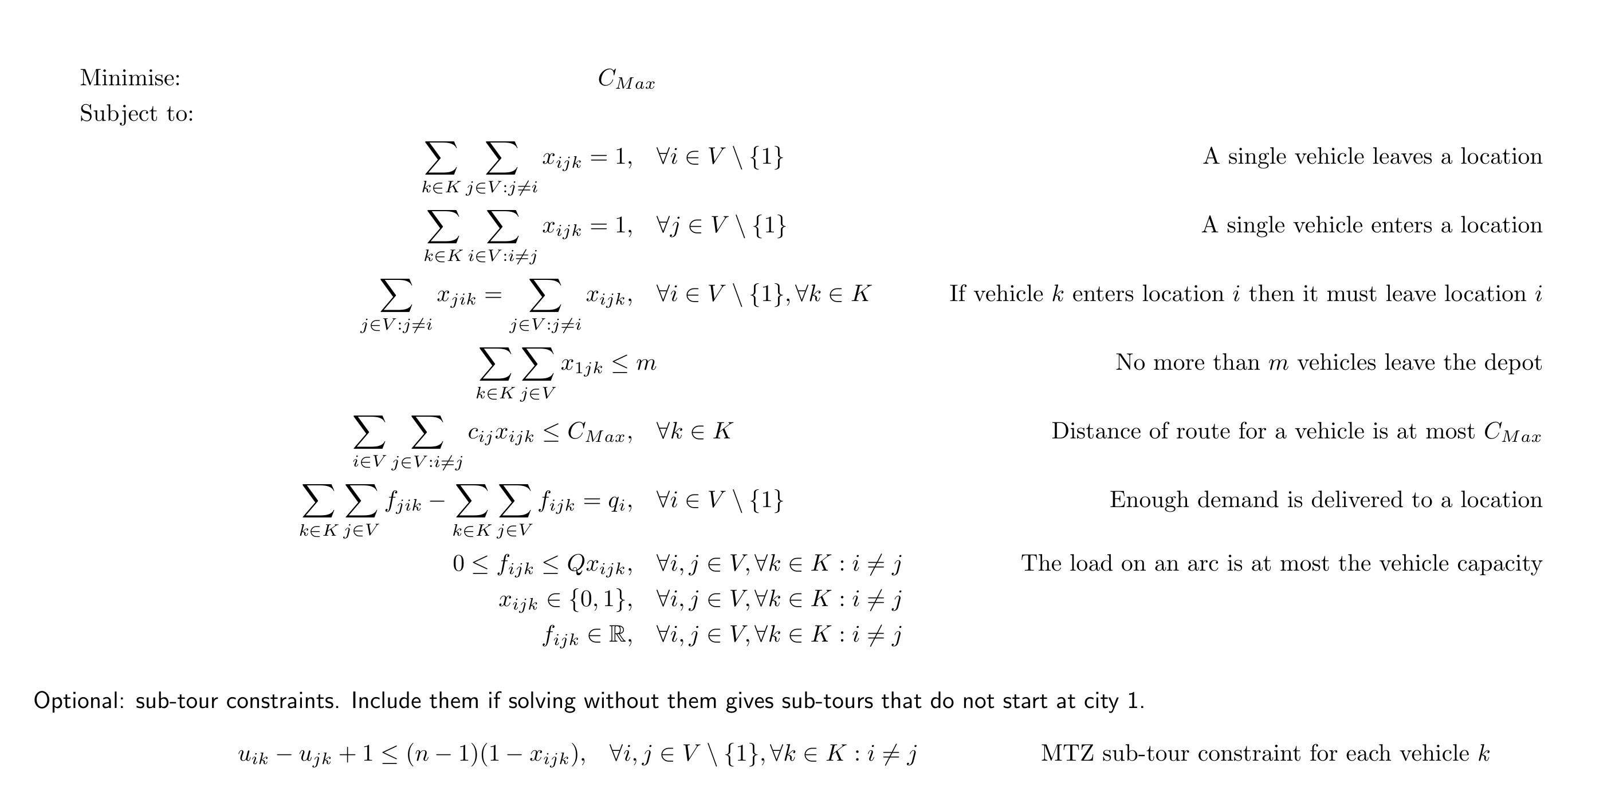
Full Model

Slide 34
Vehicle Routing on a Subgraph
Route m vehicles to visit a set of locations S subset of V.
Do we need the whole graph?
No
We could compute the shortest path between the locations, this would then give us a distance matrix and we can solve as standard using just the locations S.
You can imagine a logistics company doing this each day, working out the distances between delivery locations and then running a VRP model.

Slide 35
Conclusion
Discrete Optimisation is Cool!
It is also a fact of life!

Slide 36
Interactive Notebook
The demonstration notebook runs in your browser on the course site: Week 10, 2 Lecture Demos, 1 TSP and VRP with Pyomo.ipynb.

